Slide 1





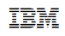









Operational Threat & Risk Information Sharing and Analytics
TEAM Threat

Slide 2
Problem Space
There is a critical need to understand and mitigate threats and risks – to “connect the dots”.
The Landscape of threats is changing
Multiple attack vectors, cyber/physical and other
Advanced threats utilize multiple vulnerabilities
There are multiple communities addressing the same threats
Cyber/physical, emergency management, safety, defense, etc.
No comprehensive consistent semantic framework
Existing systems provide insular treatment of threat/risk relationships
Comprehensive system would allow system-of-systems interoperability (private/private, public/private)

Slide 3
What we need is an integrating framework that supports automated data mapping
Cyber
Crime
Terrorism
Critical Infrastructure
Natural
Disasters
Integrating Framework for Threats and Risks
Sharing & Analytics
Sharing & Analytics
Sharing & Analytics
Sharing & Analytics
Sharing & Analytics
An integrating framework that helps us deal with all aspects of a risk or incident
A federation of risk and threat information sharing and analytics capabilities

Slide 4
Primary classes of use cases
Transformation from one information sharing data format to another
Example: STIX Cyber Event to NIEM to a CAP Alert
Analytics of information federated from multiple sources
Examples:
Fusion center “connects the dots” between a stolen laptop (from NIEM) and a cyber incident (From STIX)
Bio hazard detected by automated instruments and collaborated by local health care professionals

Slide 5


Shift in information sharing approach
Schema Based
Concept Based
Ask every stakeholder and system to adapt to externally imposed fixed schema, change in schema or systems requires development
Ask every stakeholder to map their schema to shared concepts, data mappings are automated & agile

Slide 6
Approach
Highlight O(N) vs. O(N^2)
Cyber
Terrorism
Construct a conceptual model informed by existing schema, research and best practices
This conceptual model is independent of specific data structures, technologies and terminologies
Define mapping models between the conceptual model and purpose/technology schema
Make both models sufficiently precise that they can drive automated bridging between any mapped schema
Cyber
Cyber
Cyber
Disasters
Map/Bridge
Map/Bridge
Map/Bridge
Conceptual Model
Map/Bridge
Map/Bridge
Criminal
Cyber
Criminal
Infrastructure

Slide 7

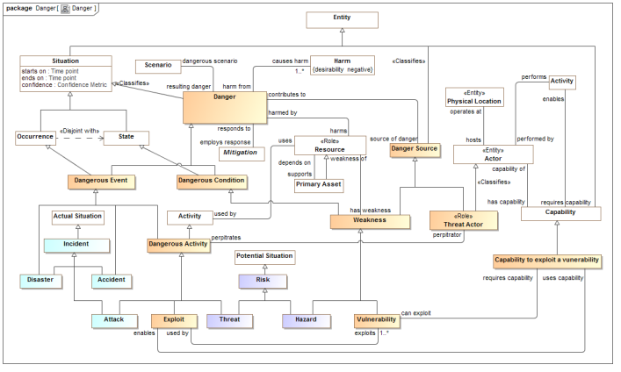
Conceptual Model Inputs
KDM
(Risk)
NIST Framework
Conceptual Model
NIEM
(General)
STIX
(Cyber)
OGC
(Geo)
EDXL
(Emergency)
FIBO (Finance)
SEI
(Safety)
CAL OES
(Health)
ISO
(Risk)
ISO
(Units)
RMS
(Custody)
There is still more to do to fully integrate the above and we anticipate more inputs and use cases

Slide 8
Models to Capabilities
Mappings
Conceptual Model
Vocabularies
Ontologies
Data Schema
STIX, NIEM, EDXL, Others
Data Transformations
Products and services implementing the standard provide the capacities for information sharing, federation and analytics based on mappings to data-focused technologies

Slide 9
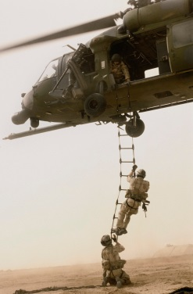
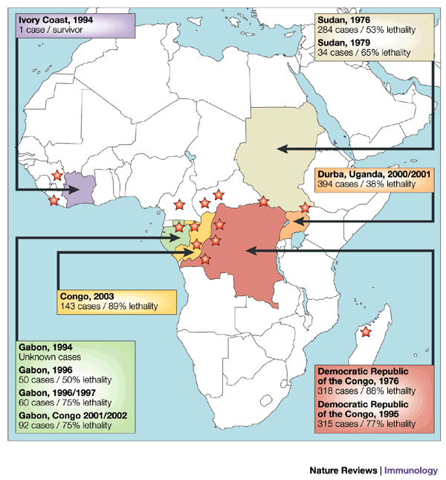

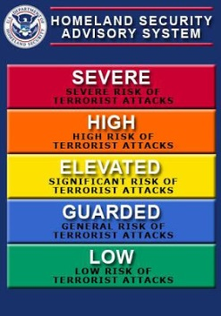



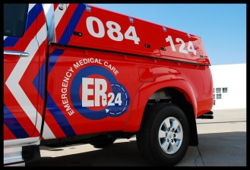


Stakeholder roles in our community
Risk/Threat
Information Sources
Data Fusion
& Brokers
Analysts
Defenders
Responders
Vendors & Service Providers
One organization may play multiple roles

Slide 10
Use Case – Critical Infrastructure
Target: A group of organizations that collaboratively manage critical infrastructure and utilize Industrial Control Systems.
Power, water and other critical infrastructure are threatened by cyber and physical terrorism.
Industrial Control Systems are increasingly computer controlled and connected (directly or indirectly) to the internet and may embed compromised control hardware/software from questionable sources.

Slide 11




Potential Information Flows
Suspicious Activity Report
NIEM
Incident
Arrest Report
STIX Incident
Tactical Response Unit
Fusion Center
Intelligence
Report
IT System Hardening
Manual Shutdown
Public CAP Warning

Slide 12

Example - Snowmageddon
In January 2015 Massachusetts faced the Hazard of major winter storms across the region. Potential Harm from blizzards and winter storms includes negative economic impact, limited road accessibility, restricted emergency management, non-availability of utility, property damage, personal injury and death, and more.
The onset of a winter storm or blizzard was predicted by the National Weather Service (NWS).

Slide 13
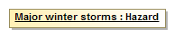
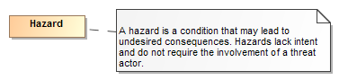
Example of structuring risk information
In January 2015 Massachusetts faced the Hazard of major winter storms across the region.
Is formalized as
Is defined by
A data syntax and vocabulary
Maps To
<drn:PotentialDanger>Major winter storms</drn:PotentialDanger>

Slide 14
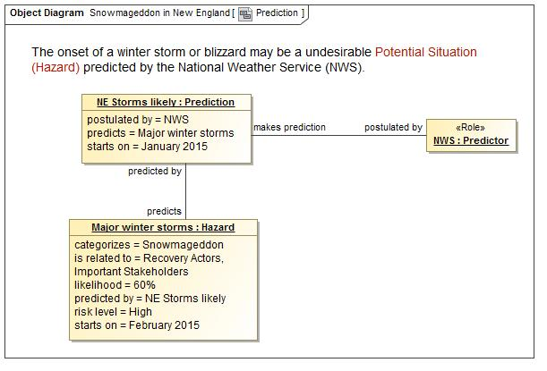
A Potential Storm? Who said this?

Slide 15
Precepts
The purpose/organizational/technology specific schema will not (should not) go away
A “one size fits all” solution will not work
There will be no one technology
There will be no one terminology or language
There will be no one data structure for threats and risks
Our focus is federation
Understanding the concepts behind the schema
Mapping them to/through a common conceptual model
Enabling interoperability by bridging between the specific schema
Supporting integration and coordination of mitigation and response capabilities

Slide 16
Core Concept: Comprehending Planned and Unplanned Threats
“All hazards” include man-made and natural disasters/system failures
There is not always an actor involved (e.g. hurricane, system malfunction)
Intentional threat actors are not the only source of threats
Non-malicious actors may constitute significant threat (e.g. spear-phishing victim, power plant operator)
Defenders (e.g. system admins, law enforcement, medical staff) are also actors with defensive plans
Victims are actors as well

